Slide 1
Search Engine Optimization
Optimize Organic Search

Slide 2
SEO is an acronym that stands for search engine optimization, which is the process of optimizing your website to get organic, or un-paid, traffic from the search engine results page.

Slide 3
Maslow's hierarchy of needs is a motivational theory in psychology comprising a five-tier model of human needs, often depicted as hierarchical levels within a pyramid.
From the bottom of the hierarchy upwards, the needs are: physiological, safety, love and belonging, esteem, and self-actualization.

Slide 4
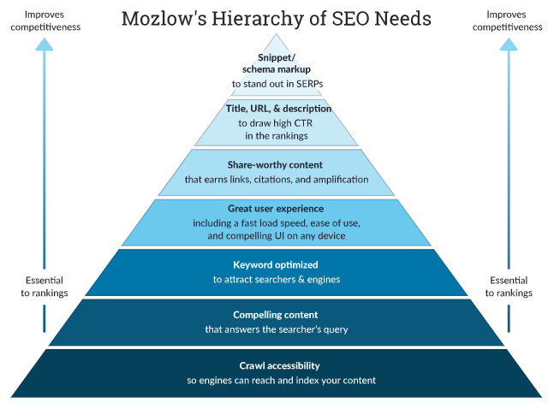

Slide 5
Organic Results
Search engines do all of this by discovering and cataloguing all available content on the Internet (web pages, PDFs, images, videos, etc.) via a process known as “crawling and indexing,” and then ordering it by how well it matches the query in a process we refer to as “ranking.

Slide 6
Organic Results
Title Tag
Meta Description
Sub-Heading
Internal Links
Image Name and ALT Tags
Notes:
Title Tag
The title tag on each page tells the search engines what your page is about. This should be 70 characters or less, including both the keyword your content focuses on and your business name
Meta Description
The meta description on your website tells search engines a little bit more about what each page is about. This is also used by your human visitors to better understand what the page is about and if it’s relevant. This should include your keyword and also provide enough details to tell the reader what the content is about
Sub-headings
Not only do sub-headings make your content easier for visitors to read, but it can also help improve your SEO. You can use H1, H2, and H3 tags to help search engines better understand what your content is about
Internal Links
Building internal links, or hyperlinks to other content on your site, can help search engines learn more about your site. For example, if you are writing a post about the value of a specific product or service, you can link to the product or service page in your blog post
Image Name and ALT Tags
If you are using images on your website or within your blog content, you will also want to include your keyword or phrase in the image name and alt tag. By including this information, you also help give your SEO definition. This will help search engines better index your images, which may appear when users perform an image search for a certain keyword or phrase

Slide 7
White hat vs Black hat SEO
"Black hat SEO" refers to techniques and strategies that attempt to spam/fool search engines.
While black hat SEO can work, it puts websites at tremendous risk of being penalized and/or de-indexed (removed from search results) and has ethical implications.
"White hat SEO" refers to SEO techniques, best practices, and strategies that abide by search engine rule.
It’s primary focus to provide more value to people.

Slide 8
How Search Engines Work?
Crawl
Index
Rank

Slide 9
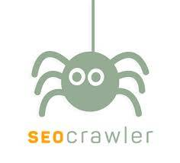
Crawl
Crawling is the discovery process in which search engines send out a team of robots (known as crawlers or spiders) to find new and updated content. Content can vary — it could be a webpage, an image, a video, a PDF, etc. — but regardless of the format, content is discovered by links.
Notes:
Image Source - https://www.google.com/imgres?imgurl=https%3A%2F%2Fseocrawler.io%2Fwp-content%2Fuploads%2F2017%2F06%2FSEO-TOOL.jpg&imgrefurl=https%3A%2F%2Fseocrawler.io%2F&tbnid=J65sKx9KKyl-5M&vet=12ahUKEwjIwbGcyqHrAhVUJbcAHRIuDWEQMygHegUIARDBAQ..i&docid=61mmEr3bbVyczM&w=236&h=214&q=seo%20crawl&ved=2ahUKEwjIwbGcyqHrAhVUJbcAHRIuDWEQMygHegUIARDBAQ

Slide 10
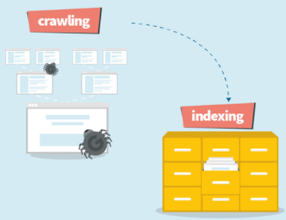
Index
Search engines process of gathering of contents found during the crawling process. And store the information they find in an index, a huge database of all the content they’ve discovered and deem good enough to serve up to searchers
Notes:
Image Source - https://qph.fs.quoracdn.net/main-qimg-e36e9425cb7bc16ba7c615fbf20ef7f3

Slide 11
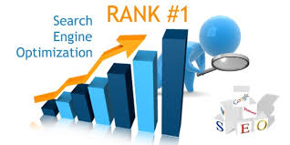
Rank
In SEO, ranking refers to your content's position on the search engine results pages (SERPs). A #1 ranking means that when people search for a particular term, your web page is the first result.
When someone performs a search, search engines scour their index for highly relevant content and then orders that content in the hopes of solving the searcher's query.
Notes:
Image Source - https://www.google.com/imgres?imgurl=http%3A%2F%2Fmannarshidigitalsolutions.com%2Fwp-content%2Fuploads%2F2018%2F12%2Fseo-rankings.jpg&imgrefurl=http%3A%2F%2Fmannarshidigitalsolutions.com%2F2018%2F12%2F18%2Fseo-ranking-factors-2019%2F&tbnid=kYKOBQ4-7jb-jM&vet=12ahUKEwie8cDwyaHrAhUTQ3wKHe65BekQMygIegUIARDPAQ..i&docid=0BrqEn7DbcgoAM&w=600&h=300&q=seo%20rank&ved=2ahUKEwie8cDwyaHrAhUTQ3wKHe65BekQMygIegUIARDPAQ

Slide 12
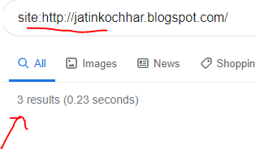
Crawling – Test Web Pages
If site is not showing up anywhere in the search results, there are a few possible reasons why:
Your site is brand new and hasn't been crawled yet.
Your site isn't linked to from any external websites.
Your site's navigation makes it hard for a robot to crawl it effectively.
Your site contains some basic code called crawler directives that is blocking search engines.
Your site has been penalized by Google for spams tactics.
In Google and type "site:yourdomain.com" into the search bar. This will return results Google has in its index for the site specified

Slide 13
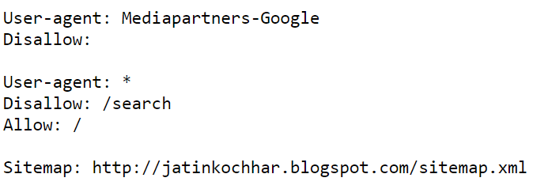
Robots.txt
yourdomain.com/robots.txt and suggest which parts of your site search engines should and shouldn't crawl, as well as the speed at which they crawl your site
Robots.txt is a text file webmasters create to instruct web robots (typically search engine robots) how to crawl pages on their website
Notes:
How Googlebot treats robots.txt files
If Googlebot can't find a robots.txt file for a site, it proceeds to crawl the site.
If Googlebot finds a robots.txt file for a site, it will usually abide by the suggestions and proceed to crawl the site.
If Googlebot encounters an error while trying to access a site’s robots.txt file and can't determine if one exists or not, it won't crawl the site.

Slide 14
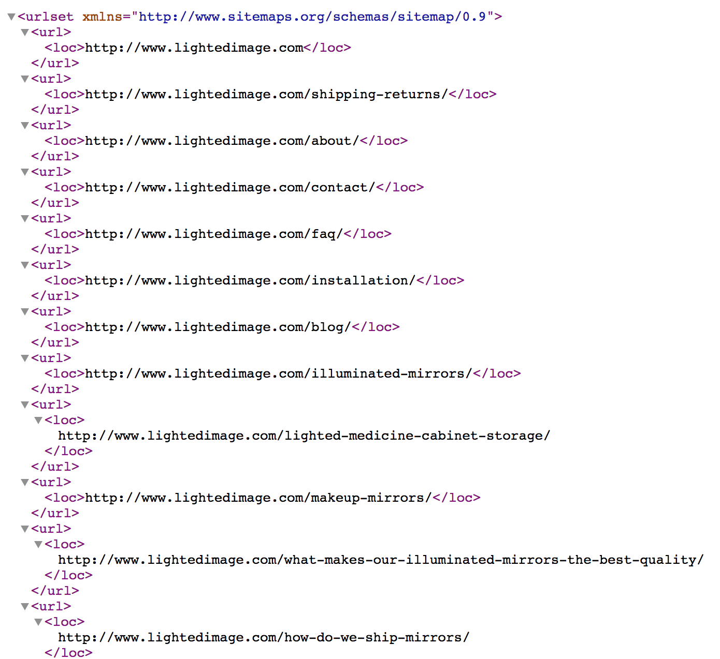
Sitemaps
A sitemap is just what it sounds like: an XML sitemap is a list of your website's URLs. It acts as a roadmap to tell search engines what content is available and how to reach it.
Ensure that you’ve only included URLs that you want indexed by search engines, and be sure to give crawlers consistent directions.
Notes:
Image Source - https://statcounter.com/images/insights/seo/sitemap-example-xml.png

Slide 15
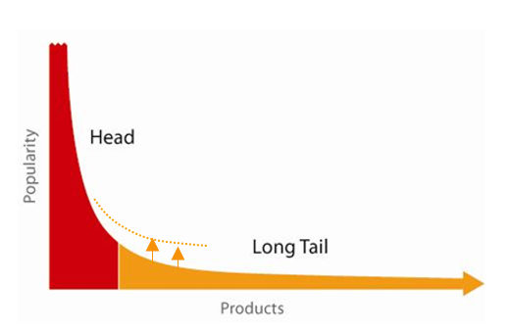
Keyword Search
Focusing on long-tail keywords is a great SEO tactic. Long-tail keywords are keywords or key phrases that are more specific – and usually longer – than more commonly searched for keywords. Long-tail keywords get less search traffic, but will usually have a higher conversion value, as they are more specific
Notes:
Image Source - https://www.apptus.com/hubfs/Long%20Tail/Long%20Tail%20Apptus%20algorithm%20-%20lift.png

Slide 16
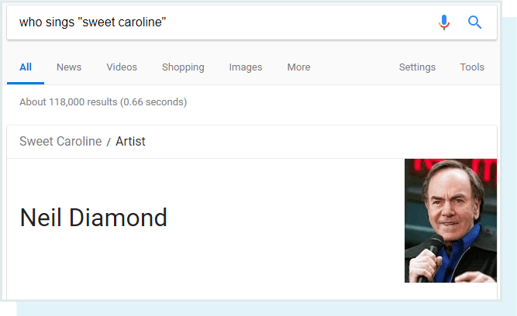
Keyword Format
Informational queries: The searcher needs information, such as the name of a band or the height of the Empire State Building
Notes:
Image Source - https://moz.com/beginners-guide-to-seo/keyword-research

Slide 17
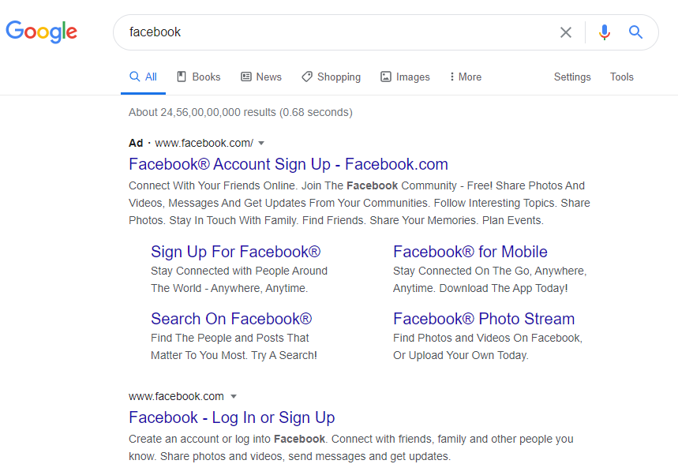
Keyword Format
Navigational queries: The searcher wants to go to a particular place on the Internet, such as Facebook or the homepage of the NFL

Slide 18
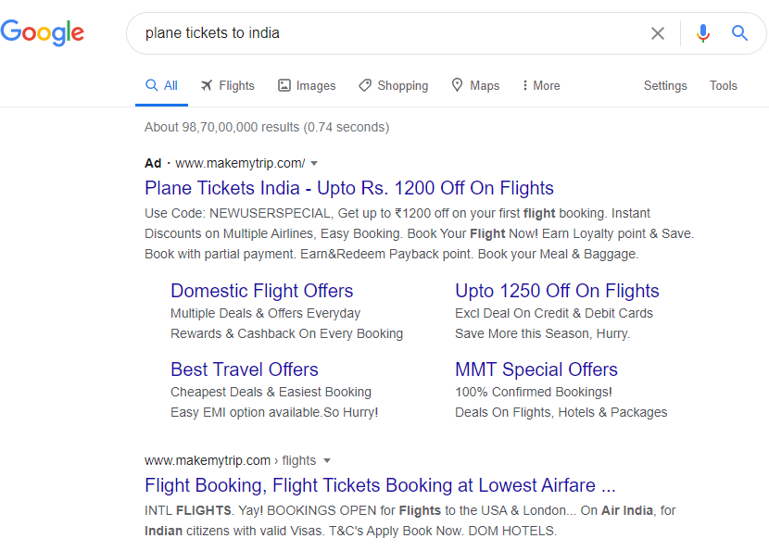
Keyword Format
Transactional queries: The searcher wants to do something, such as buy a plane ticket or listen to a song

Slide 19
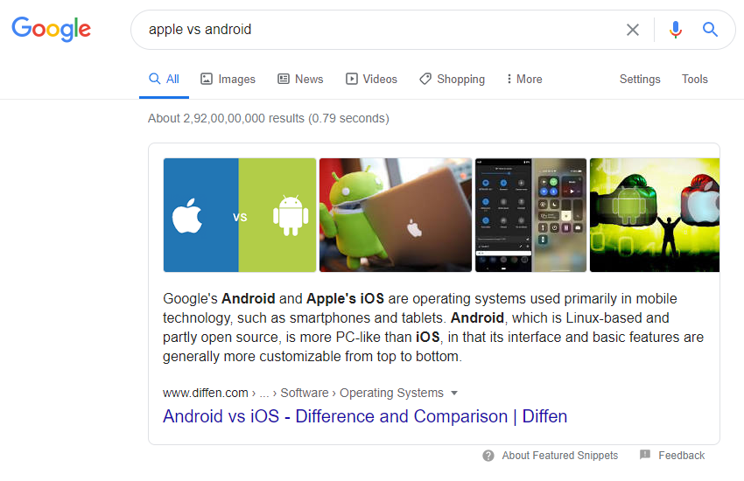
Keyword Format
Commercial investigation: The searcher wants to compare products and find the best one for their specific needs

Slide 20
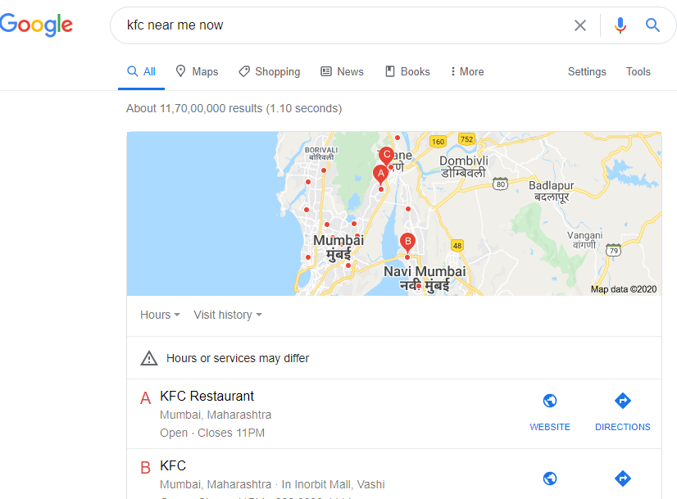
Keyword Format
Local queries: The searcher wants to find something locally, such as a nearby coffee shop, doctor, or music venue

Slide 21
Tracking SEO Performance
Conversion Rate
Time on Page
Pages per Visit
Bounce Rate
Scroll Depth

Slide 22
Tracking SEO Performance
Conversion rate
The number of conversions (for a single desired action/goal) divided by the number of unique visits. A conversion rate can be applied to anything, from an email signup to a purchase to account creation. Knowing your conversion rate can help you gauge the return on investment (ROI) your website traffic might deliver.
Time on page
How long did people spend on your page? If you have a 2,000-word blog post that visitors are only spending an average of 10 seconds on, the chances are slim that this content is being consumed (unless they’re a mega-speed reader). However, if a URL has a low time on page, that’s not necessarily bad either. Consider the intent of the page. For example, it’s normal for “Contact Us” pages to have a low average time on page.

Slide 23
Tracking SEO Performance
Pages per visit
Was the goal of your page to keep readers engaged and take them to a next step? If so, then pages per visit can be a valuable engagement metric. If the goal of your page is independent of other pages on your site (ex: visitor came, got what they needed, then left), then low pages per visit are okay.
Bounce rate
"Bounced" sessions indicate that a searcher visited the page and left without browsing your site any further. Many people try to lower this metric because they believe it’s tied to website quality, but it actually tells us very little about a user’s experience. We’ve seen cases of bounce rate spiking for redesigned restaurant websites that are doing better than ever. Further investigation discovered that people were simply coming to find business hours, menus, or an address.

Slide 24
Tracking SEO Performance
Scroll depth
This measures how far visitors scroll down individual webpages. Are visitors reaching your important content? If not, test different ways of providing the most important content higher up on your page, such as multimedia, contact forms, and so on. Also consider the quality of your content. Are you omitting needless words? Is it enticing for the visitor to continue down the page? Scroll depth tracking can be set up in your Google Analytics.

Slide 25
References
https://moz.com/beginners-guide-to-seo
https://www.lyfemarketing.com/blog/what-is-seo-and-how-it-works/

Slide 26
Thank You!
For any queries connect me at jatinkochhar@hotmail.com

